Slide 1
DESIGN OF ULTRA-WIDEBAND ANTENNA
By
Student names
N.Divya Soundharya
211714106026, Final year, ECE.
S.Lekha Priyadharshini
211714106069, Final year, ECE.
P.Nivethitha
211714106085, Final year, ECE.
UNDER THE GUIDANCE OF
Mr. L. Franklin Telfer
Assistant Professor
ECE

Slide 2
Introduction
Ultra wide band is a technology for transmitting information spread over a large bandwidth with low power utilization.
UWB technology transmit and receive pulse based waveform compressed in time.
This technology occupies over 500MHz bandwidth.
Printed antenna is frequently used in ultra wide band antenna designs due to its advantage such as light weight, ease of integration, small size, broad bandwidth and compact.

Slide 3
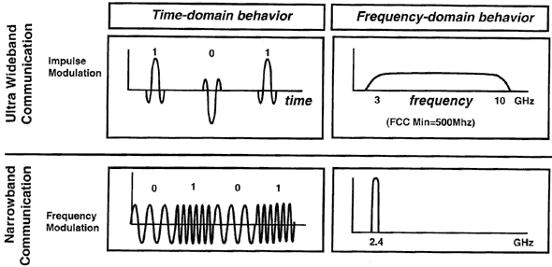
Introduction(cont.)

Slide 4
Objective
To design of UWB Antenna.
Simulation and fabrication of UWB Antenna.
Optimization of dimensions to improve the Bandwidth(%), Gain(dBi), Directivity(dB).

Slide 5
Literature Review
S.No | Title | Author Name | Published year | Inference
1. | Miniaturized W Slot Ultra Wide Band Microstrip Antenna for Short Distance Communication | Ragini Mishra, R.Kalyan and Y.M. Dubey | 2017 | Fr-4 Substrate UWB antenna is integrated with W shape notch to reduce interference
2. | A Design of Compact ultra-wide Band Antenna with Dual Band Notched Characteristics | Pooja Meena, Anurag Garg | 2017 | Different shapes Fr-4 Substrate
3. | Improved Radiation Characteristics of Small Antipodal Vivaldi Antenna for Microwave and Millimeter Wave Imaging Applications. | Moosazadeh, Mahdi | 2017 | Increase antenna gain at low frequencies. Used for high range resolution imaging of construction materials

Slide 6
Literature Review
S.No | Title | Author Name | Published year | Inference
4. | A Design of Compact ultra-wide Band Antenna with Dual Band Notched Characteristics | Ragini Mishra, R.Kalyan and Y.M. Dubey | 2017 | Fr-4 Substrate UWB antenna is integrated with W shape notch to reduce interference
5. | Comparison of Different Shapes in Microstrip Patch Antenna for X-band Applications | R. Kiruthika and et.al | 2016 | Different shapes Rectangular Patch design showed high performance.
6. | Comparative study of different feeding mechanisms on thermally stable resonator antenna | Kumar Mohita and et.al | 2015 | Feeding Techniques Microstrip feeding showed best results (Fabrication error is less)

Slide 7
Existing Model
Micro strip rectangular patch antenna with micro strip line feed.
Substrate-FR4.
The range of proposed antenna is 3.4 GHz to 11 GHz and return loss of 36 dB at resonant frequency is 4.4 GHz.
The parameter of hexagon W slot antenna is simulated using High frequency HFSS software.

Slide 8
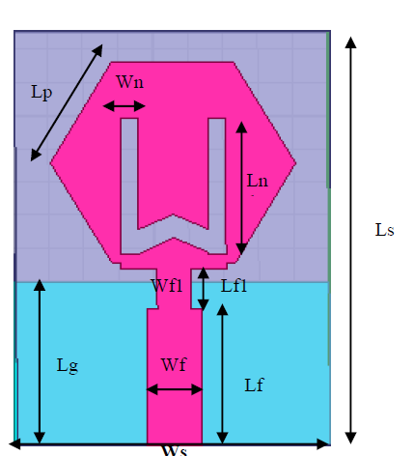
Existing Model(cont.)
UWB circular monopole antenna

Slide 9
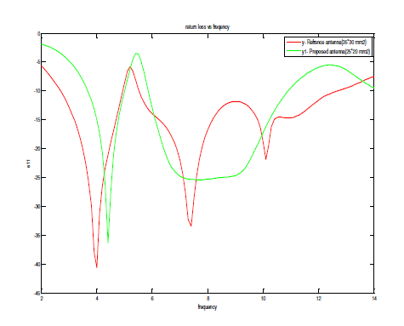
Existing Model(cont.)
Return loss (S11) Variation with Frequency

Slide 10
Existing Model(cont.)
The plot of return loss is compared with reference antenna which consist N slot and size is 25*00 mm² which is much bigger than proposed antenna size is 15*20 mm².
The fabrication of the antenna not done here.

Slide 11
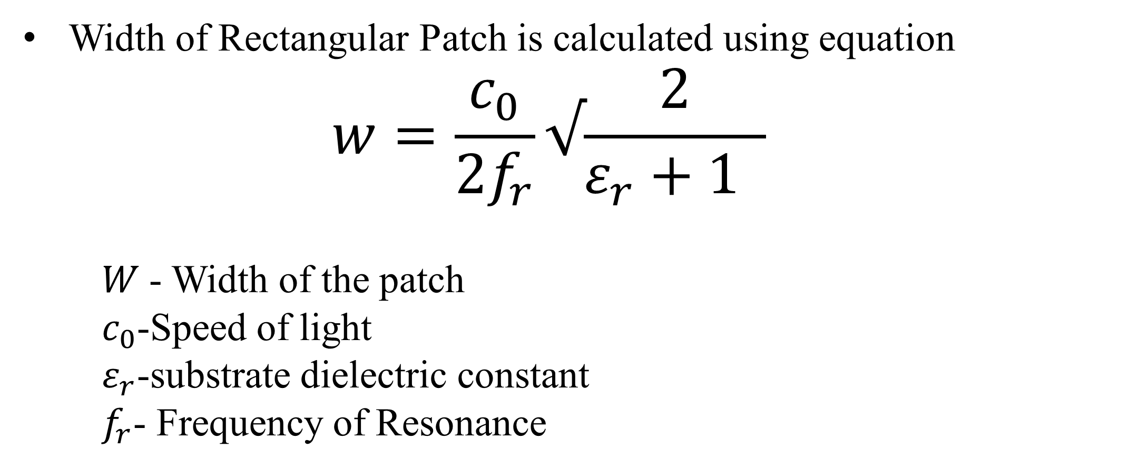
Design Equation
Width of Rectangular Patch is calculated using equation
$$w=\frac{c_{0}}{2f_{r}}√\frac{2}{ε_{r}+1 }$$
𝑊 - Width of the patch
$c_{0}$-Speed of light
$ε_{r}$-substrate dielectric constant
$f_{r}$- Frequency of Resonance

Slide 12



Design equation(cont.)
Length Rectangular Patch is calculated using equation
Effective dielectric constant $ε_{reff}$
Fringing effect of patch$∆L$

Slide 13

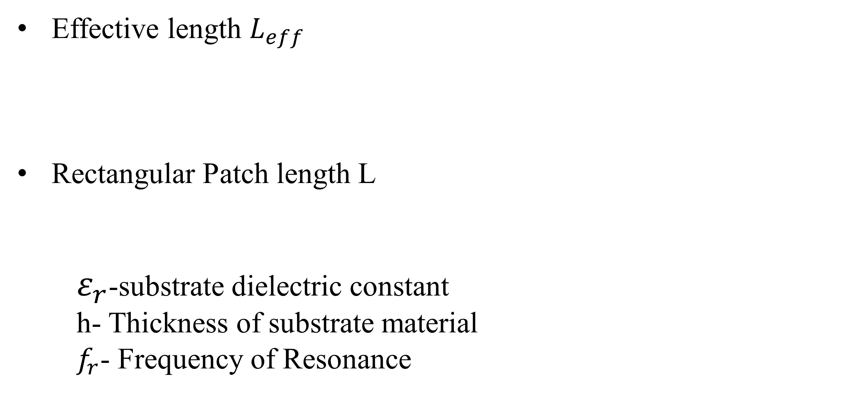
Design equation(cont.)
Effective length $L_{eff}$
Rectangular Patch length L
$ε_{r}$-substrate dielectric constant
h- Thickness of substrate material
$f_{r}$- Frequency of Resonance

Slide 14
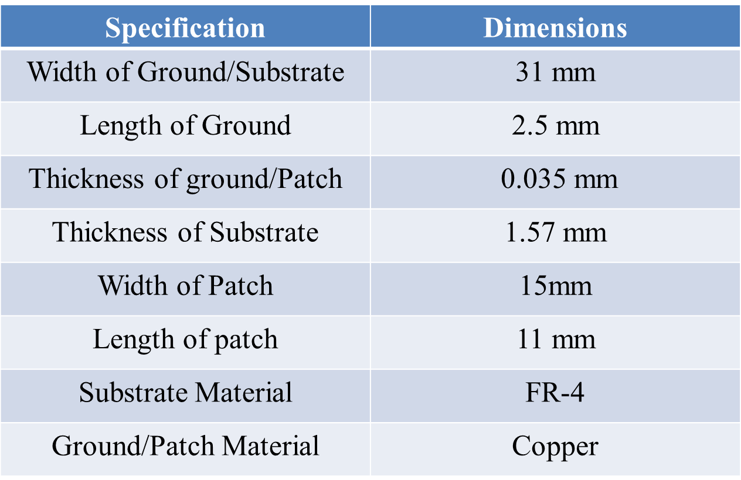
Design Specification

Slide 15
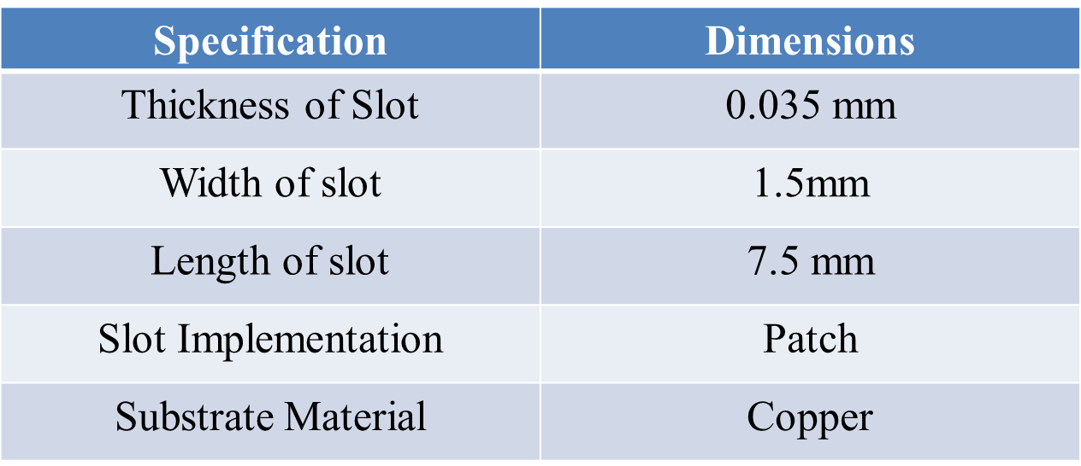
Design Specification(cont.)

Slide 16
Proposed Model
Design of Ultra wide band Antenna
Rectangular shaped patch is chosen as base structure.
FR-4 substrate used with thickness is 1.57mm.
The dielectric constant (εr) 4.4, thickness 1.6 mm, overall size 20x15 mm2, and height (h) 1.6mm.
The base of the antenna is designed using formula for simple patch antenna design’

Slide 17
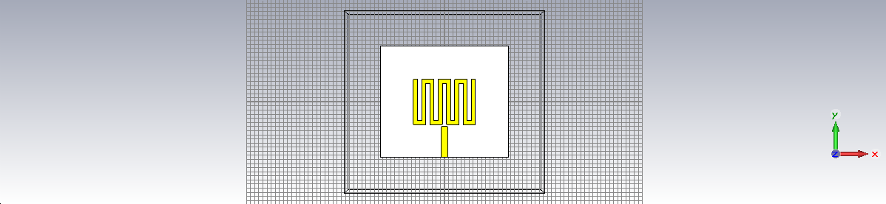
Proposed Model(cont.)
Simulation design of UWB antenna

Slide 18
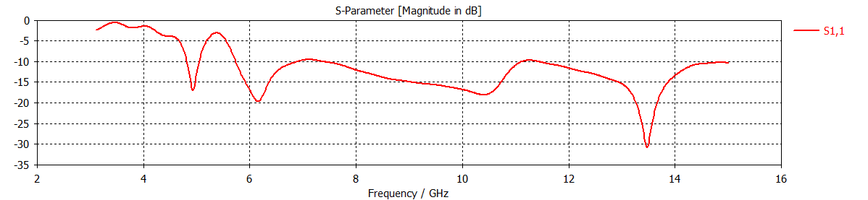
Proposed Model(cont.)
Return loss (S11) Variation with Frequency
From this the return loss observed was -31dB

Slide 19
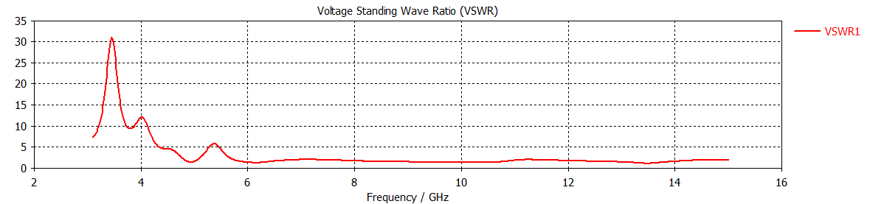
Proposed Model(cont.)
Voltage Standing Wave Ratio (VSWR)
The VSWR value at the notched bands is more and for the remaining band the value is less than 2 (VSWR < 2).

Slide 20
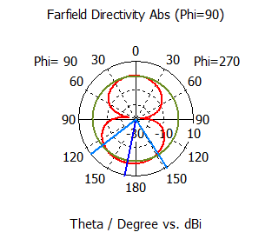
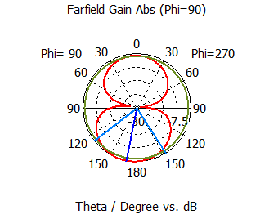
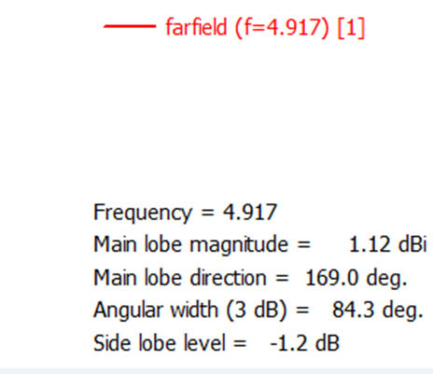
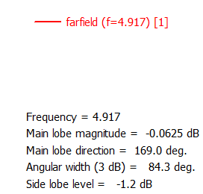
Proposed Model(cont.)

Slide 21
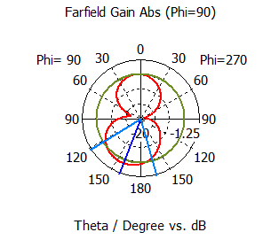
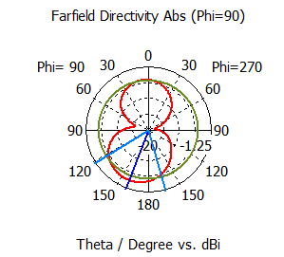
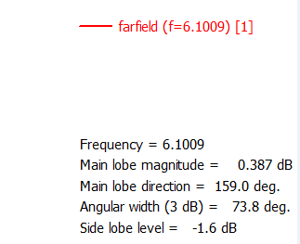
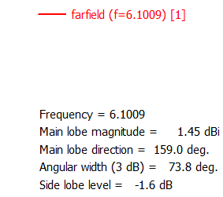
Proposed Model(cont.)

Slide 22
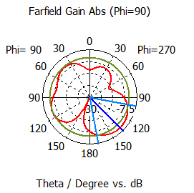
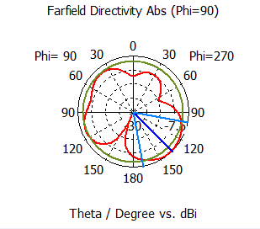
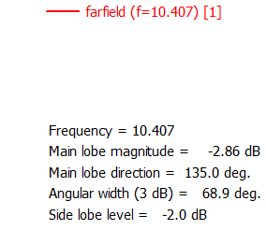
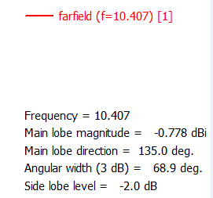
Proposed Model(cont.)

Slide 23
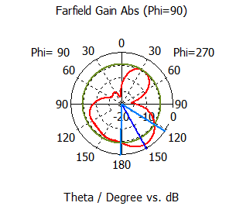
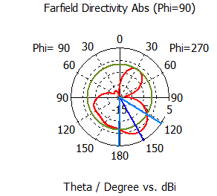
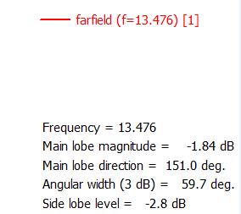
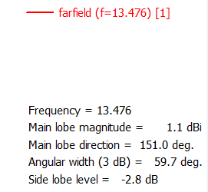
Proposed Model(cont.)

Slide 24
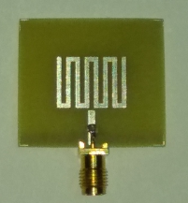
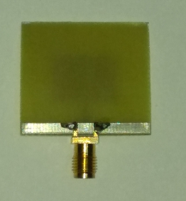
Proposed Model(cont.)
Fabricated Antenna

Slide 25
Tools Required
CST – Microwave Studio software 2014

Slide 26
References
Ragini Mishra, R.Kalyan and Y.M. Dubey ”Miniaturized W Slot Ultra Wide Band Microstrip Antenna for Short Distance Communication” International Conference on Electronics, Communication and Aerospace Technology ICECA 2017.
Pooja Meena, Anurag Garg ”A Design of Compact ultra-wide Band Antenna with DuadBand Notched Characteristics” IEEE 2017
Moosazadeh, Mahdi, et al. "Improved Radiation Characteristics of Small Antipodal Vivaldi Antenna for Microwave and Millimeter Wave Imaging Applications." IEEE Antennas and Wireless Propagation Letters (2017).

Slide 27
References
Pooja Meena, Anurag Garg ”A Design of Compact ultra-wide Band Antenna with Dual Band Notched Characteristics” IEEE 2017 .
Mayar Elsebai, Tamer Mostafa Abdelfadl, and Fawzy Ibrahim ”Frequency Transformation to Design Single Band Rectangular Patch MMW Antennas” 2017 Progress In Electromagnetics Research Symposium — Spring (PIERS), St Petersburg Russia.
Kiruthika et.al,”Comparison of Different Shapes in Microstrip Patch Antenna for X-band Applications“,International Conference on Emerging Technological Trends [ICETT]-2016.

Slide 28
Thank You

